Slide 1
7.4 Which approach produces the best results?

Slide 2
We have now seen two fundamental approaches to linear multi-class classification: the One-versus-All (OvA) and the Multi-class Perceptron / Softmax.
Both approaches are commonly used in practice and can - depending on the dataset - produce similarly good results.
However the latter approach (the Multi-class Perceptron / Softmax) is - at least in principle - capable of achieving higher accuracy on a broader range of datasets.

Slide 3
This is due to the fact that with OvA we solve a sequence of C two-class subproblems (one per class), tuning the weights of our classifiers independently of each other.
Only afterward do we combine all classifiers together to form the fusion rule.
Thus the weights we learn satisfy the fusion rule indirectly.

Slide 4
On the other hand, with the multi-class Perceptron or Softmax cost function minimization we are tuning all parameters of all C clas- sifiers *simultaneously*...
...to directly satisfy the fusion rule over our training dataset.
This joint minimization permits potentially valuable interactions to take place in-between the two-class classifiers in the tuning of their weights that cannot take place in the OvA approach.

Slide 5
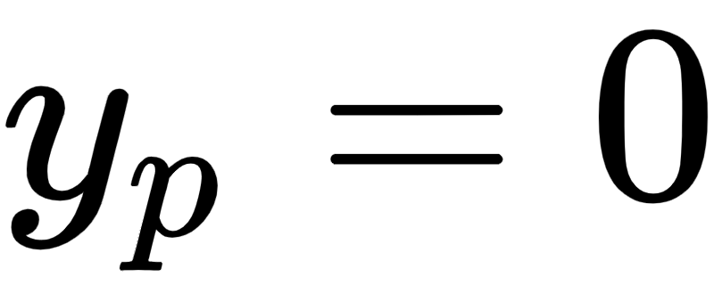
We illustrate this principal superiority of the Multi-class Perceptron / Softmax approach over OvA using a toy C = 5 class dataset shown below. Here points colored red, blue, green, khaki, and violet have label values , 1, 2 , 3, and 4 respectively.

Slide 6
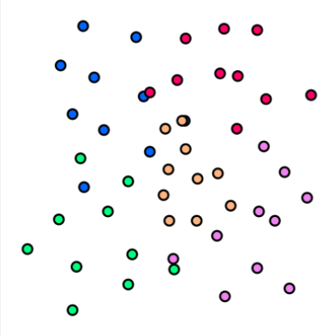

Slide 7
Think for a moment how the OvA approach will perform in terms of the khaki colored class.
In particular, think of how the subproblem in which we distinguish between members of this class and all others will be solved.
Because this class of data is surrounded by members of the other classes - and there fewer members of the khaki class then all other classes combined - the optimal classification rule for this subproblem is to classify all points as non-khaki (or in other words to misclassify the entire khaki class).

Slide 8
This implies that the linear decision boundary will lie outside the range of the points shown, with all points lying on its negative side.
The resulting individual classifier decision boundaries are shown in the left panel below.
Now because the weights of decision boundary associated with the khaki colored class are tuned solely based on this subproblem, this will lead to the entire khaki class being misclassified in the final OvA solution.
This is shown below in the right panel of the figure below, along with the fused decision boundary.

Slide 9
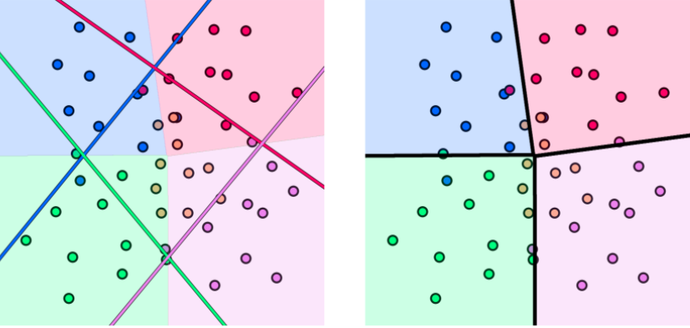

Slide 10
If - on the other hand - we employ the Multi-class Perceptron or Softmax approach we will not miss this class.
Here - because we tune all weights *together* in order to minimize the number of misclassifications over the entire dataset - we end with final fused decision boundary that is far superior to the one provided by OvA (shown in the right panel below).

Slide 11
We misclassify far fewer points and - in particular - do *not* misclassify the entire khaki class of data.
We show the individual linear decision boundaries found here as well in the left panel.
While the decision boundary associated with the khaki class lies outside the range of the datapoints, because we have tuned everything together weights in other individual decision boundaries are *adjusted to better satisfy our goal of minimizing misclassifications*.

Slide 12
